Slide 1

PASSWORD STRENGTH CHECKER
BATCH MEMBERS
GUNJAN VYAS
MRUTHULA SARAS
JOTHILEKSHMI
SHONU

Slide 2
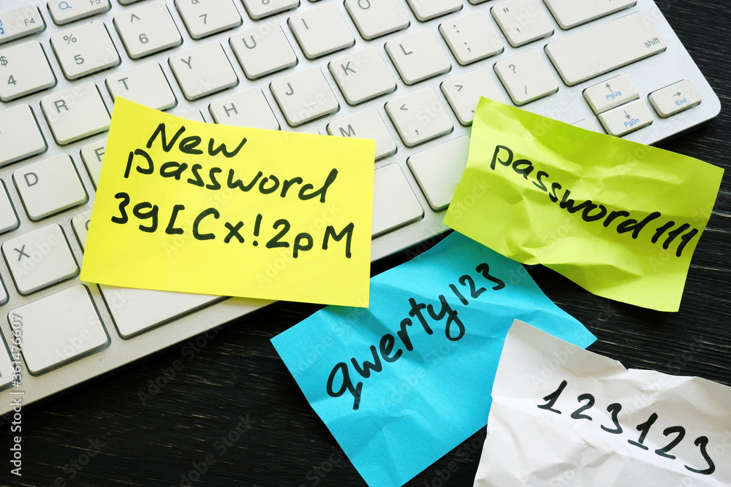
INTRODUCTION
In today’s digital age, strong passwords are essential for protecting personal information and preventing unauthorized access to online accounts. With cyberattacks becoming more sophisticated and prevalent, it’s more important than ever to create strong passwords
strong password is a unique word or phrase a hacker cannot easily guess or crack

Slide 3
OBJECTIVES
This project contains a Python code for checking the strength of password. It analysis the password and return how strong the password is based of the length, complexity and presence of certain character
Determine how strong and secure your password is

Slide 4
FEATURES
Here we check whether our password is strong enough.
It does this by checking the number of letters, numbers, special characters, and whitespace characters within a given password and generating a score based on these results.
So here we used conditional statements, functions, and string formatting.We also use the string and getpass modules from the Python standard library.
This allows us to access the full range of string characters to compare with our password’s character composition, while the .getpass() function lets us hide our password when we enter it.

Slide 5
conclusion
strong password will protect you from others attempting to use or access your account without your consent.
It protects your personal data and other private information about yourself.
This reduces possibilities of cybercrimes such as identity theft, harassment, data breaches or more happening to you

Slide 6


